Slide 1
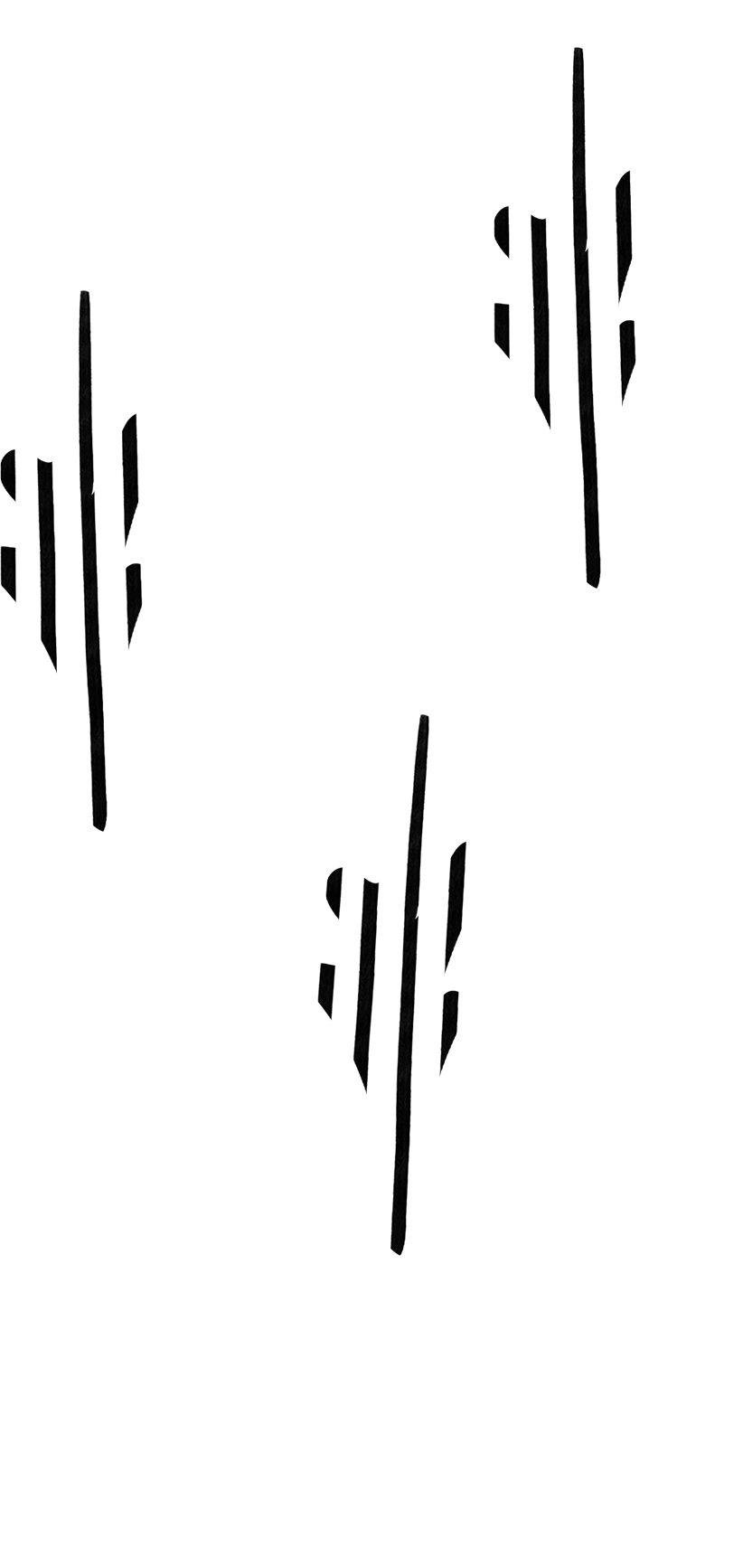


Museum Art Store
IS 410 Project
Yen Pineda

Slide 2
Business Situation
The goal of this database is to be used by art galleries to gather their data in one place, they will also be able to hold customer data who may want to purchase certain pieces of artwork. Galleries will be able to view and sort data about the pieces of art and allow for purchases. The data that will need to be stored are the details of the artist and artwork along with the customer information and their order details. We assume that these are not unique items sold and there are multiples of one piece of art.

Slide 3
Project Schedule
Business Proposal 1 Week - Create business idea and its applications, understand the need for the database
ER Diagram 1 Week - Design ER diagram which includes definitions of entities and relationships
EER Diagram 1 Week - Build EER diagram from existing ER diagram
SQL Coding 2 Weeks - Code the database and insert data into the database
SQL Query Testing 1 Week - Run tests through queries
Presentation 1 Week - Prepare and submit ideas and database

Slide 4
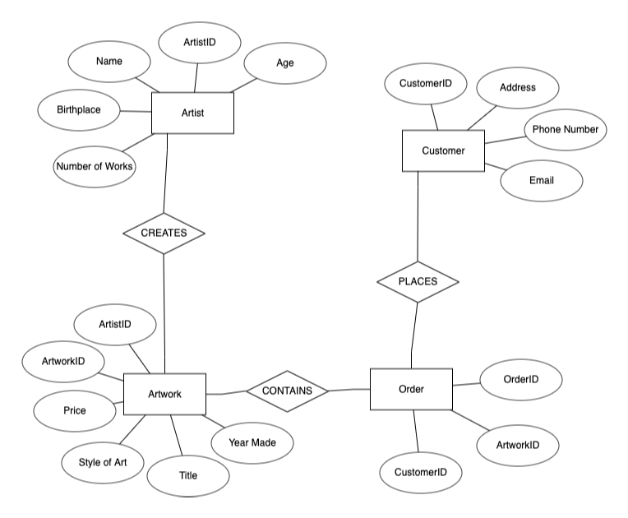
ER Diagram

Slide 5
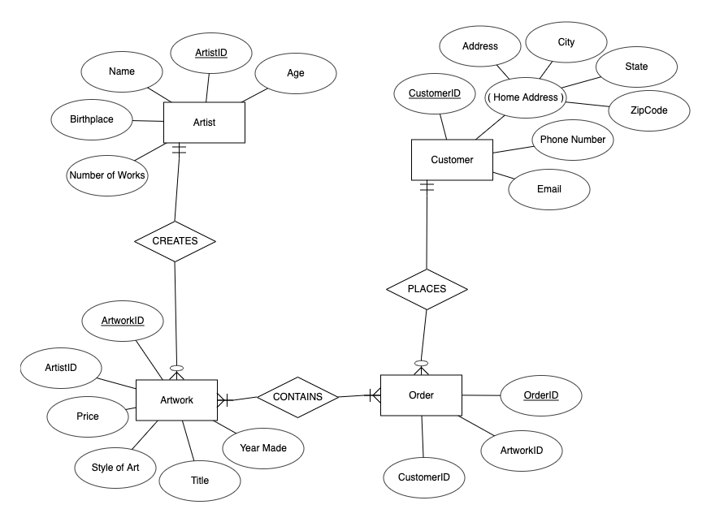
EER Diagram

